Slide 1

ERPNext Malaysia Enterprise Resources Planning Elania Resources 3rd February 2023
Virtual Perak Technology

Slide 2
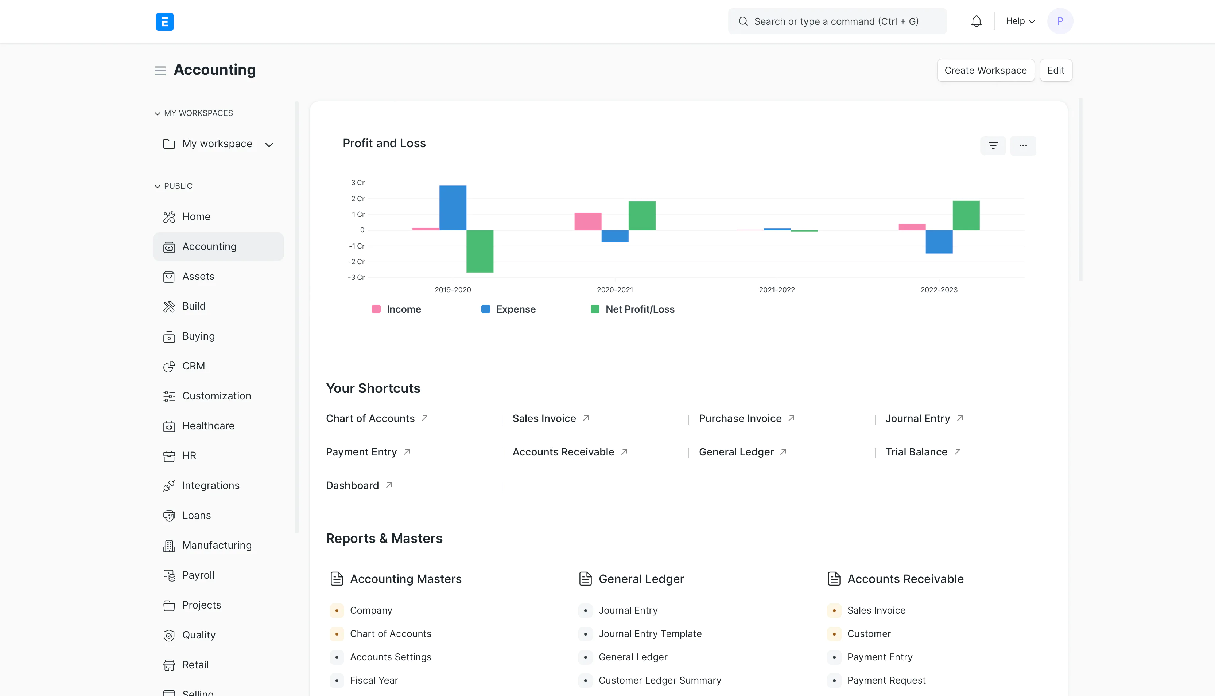
Elania Resources Updates
ERPNext Training And Service Provider
ERPNext Hosting (https://erpnext.my)

Slide 3
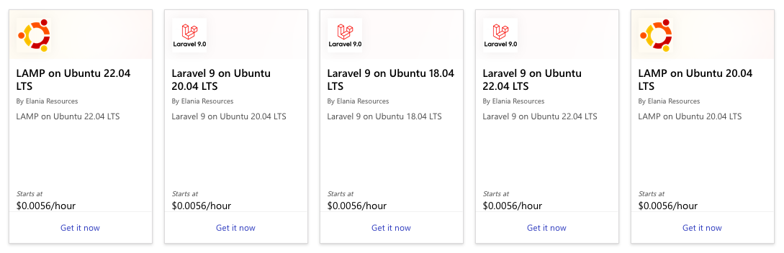
Elania Resources Updates
Authorized Microsoft Reseller
Authorized Adobe Reseller
Laravel and Ubuntu VM in Azure Marketplace

Slide 4
What is ERP?
Software to synchronize all information and communication between department within the organization.
Manage company’s activities and operations
Interactions of marketing, sales, quality control, products processes, accounting, manufacturing, distribution, stocks within a single application

Slide 5
Why do you need ERP?
Proper communications
Proper workflow and paperwork
Complete control on your business
Process automation
Higher Productivity
Better Information Management
Better Performance Measurement

Slide 6
What is ERPNext
ERPNext is an Open Source ERP System
End-to-end business solution that helps you to manage all your business information in one application
Active project since 2010
Used by more than 1000 companies in more than 100 countries
Designed for small and medium sized business
Highly customizable and extendable

Slide 7
How ERPNext Help?
Track all Invoices and Payments.
Inventory management and control
Manage payroll
Manage customers, suppliers databases and their contacts
Bill of materials and production planning
Tracking your budgets and spending
Follow ups on leads and opportunities
Billing, financial accounting and reporting
Publish your eCommerce & website

Slide 8
Industries
Manufacturing
Services
Retail
Distribution
Education
Agriculture
Health Care
Non-Profit
Hospitality

Slide 9
ERPNext Modules
Accounting
CRM
Stock
Selling
Purchasing
Manufacturing
Project Management
Human Resources
Website
E-Commerce

Slide 10
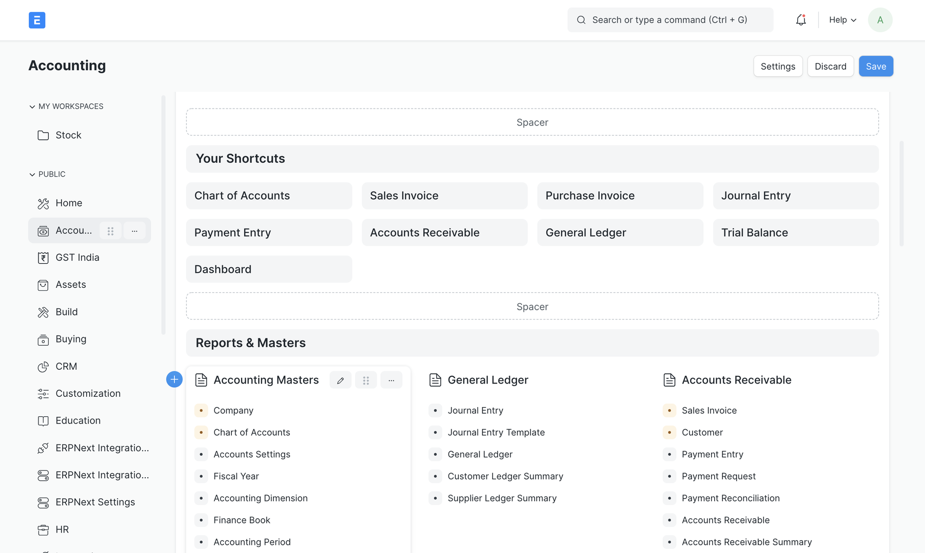
Financial & Accounting

Slide 11
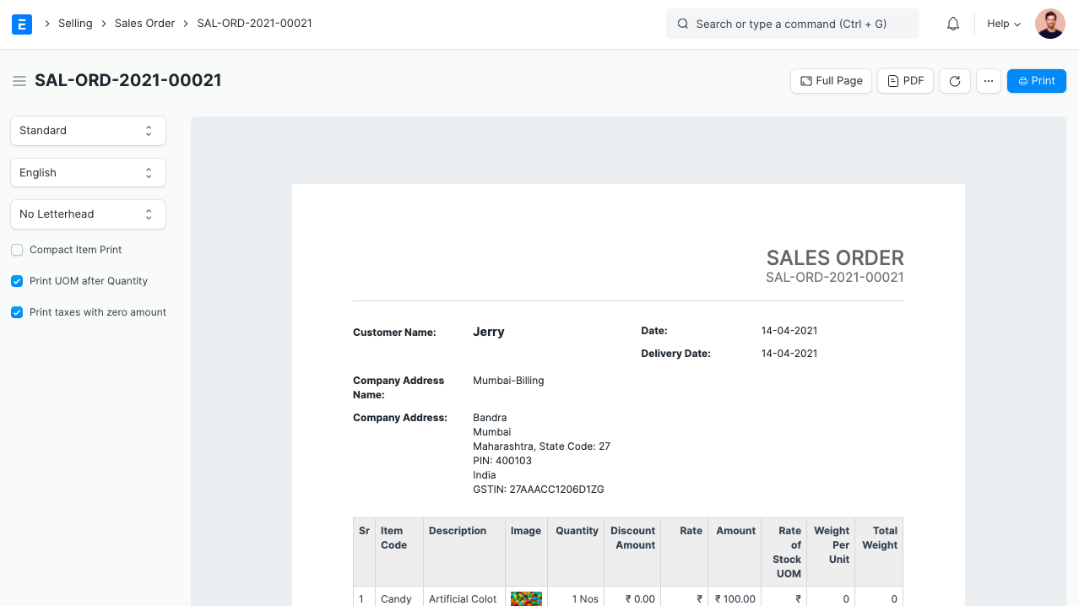
Sales & Purchase

Slide 12
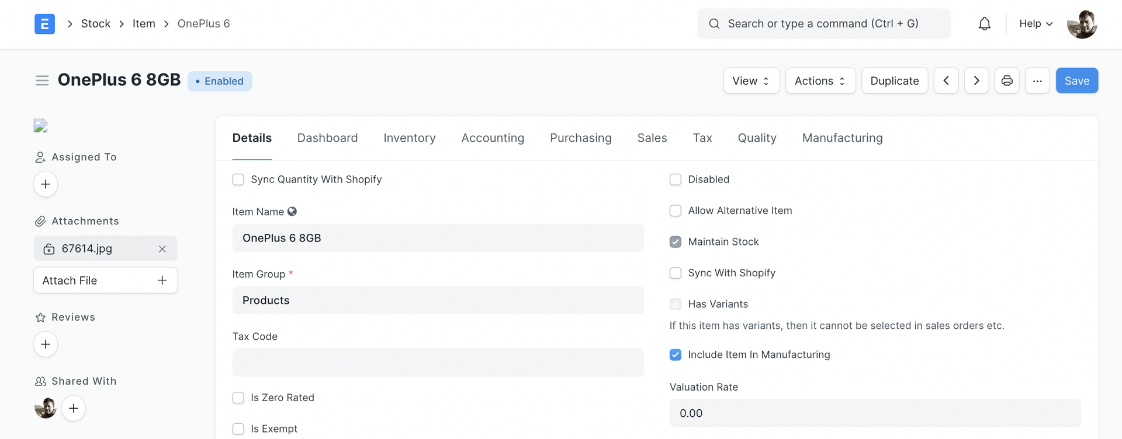
Stock Management

Slide 13
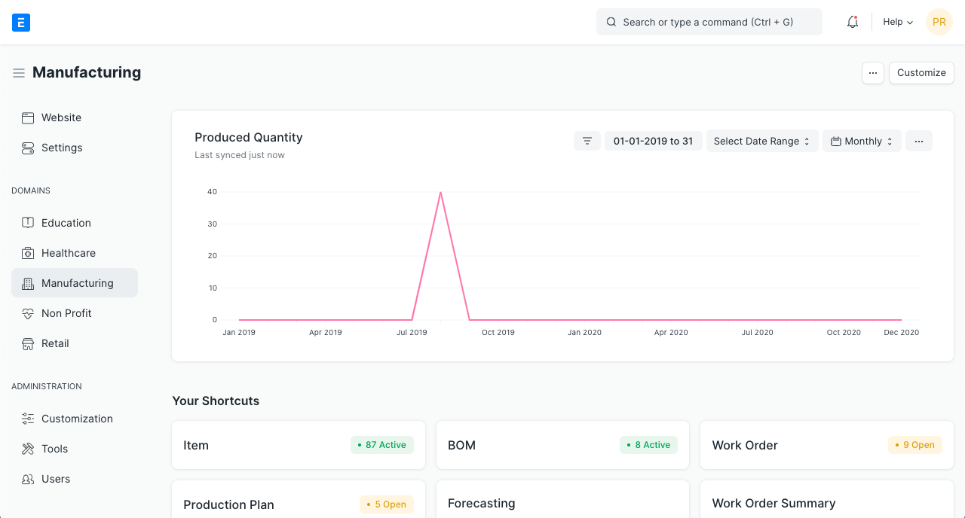
Manufacturing

Slide 14
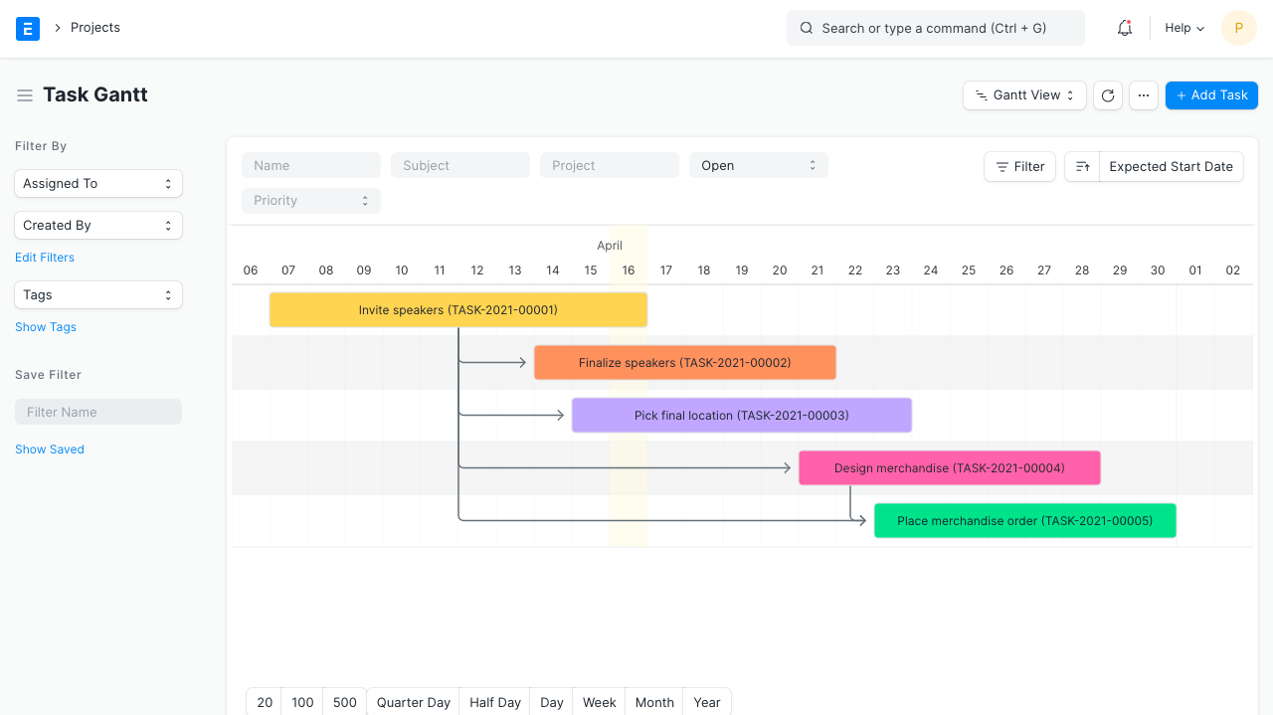
Project Management

Slide 15
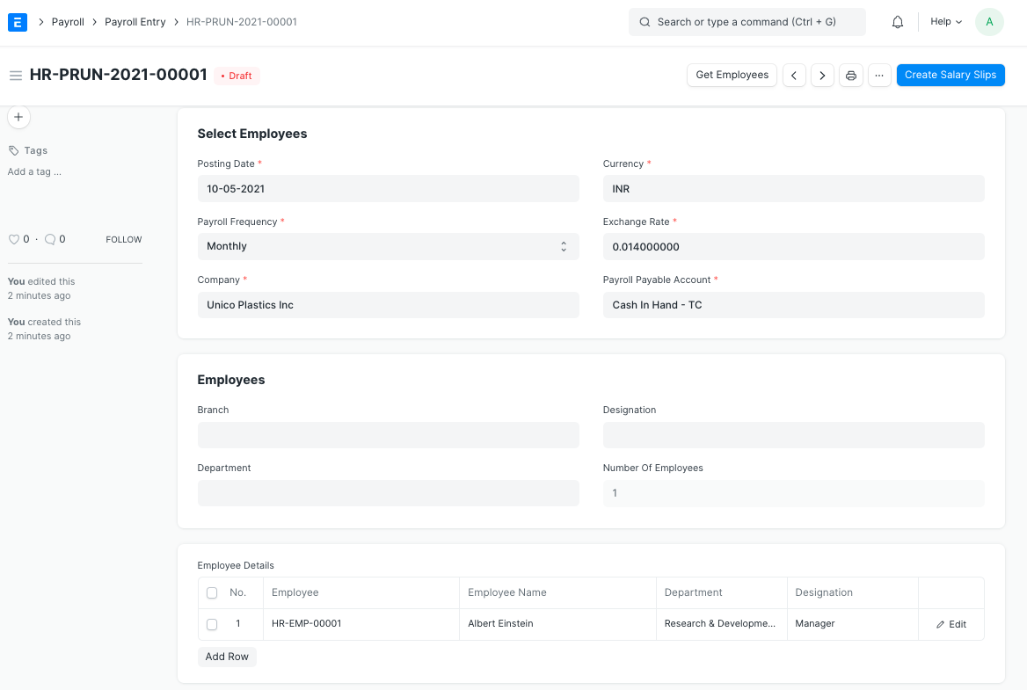
Payroll & Expenses

Slide 16
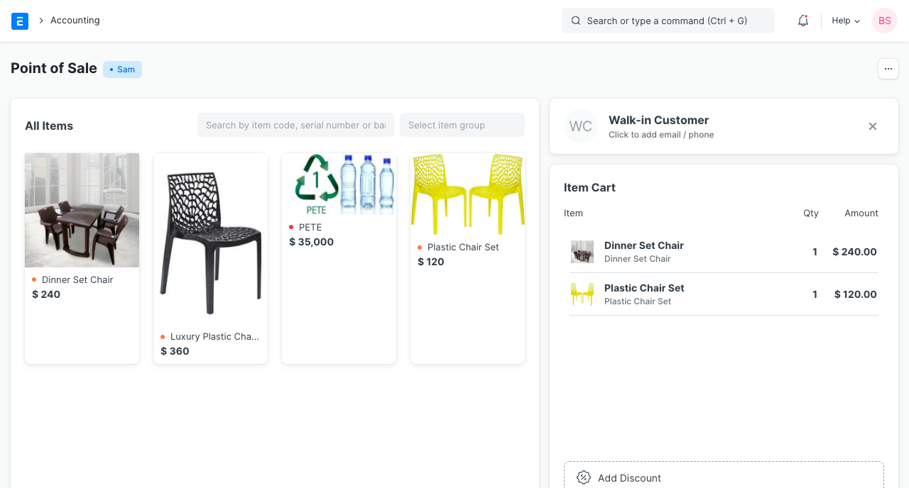
Point-of-Sales

Slide 17
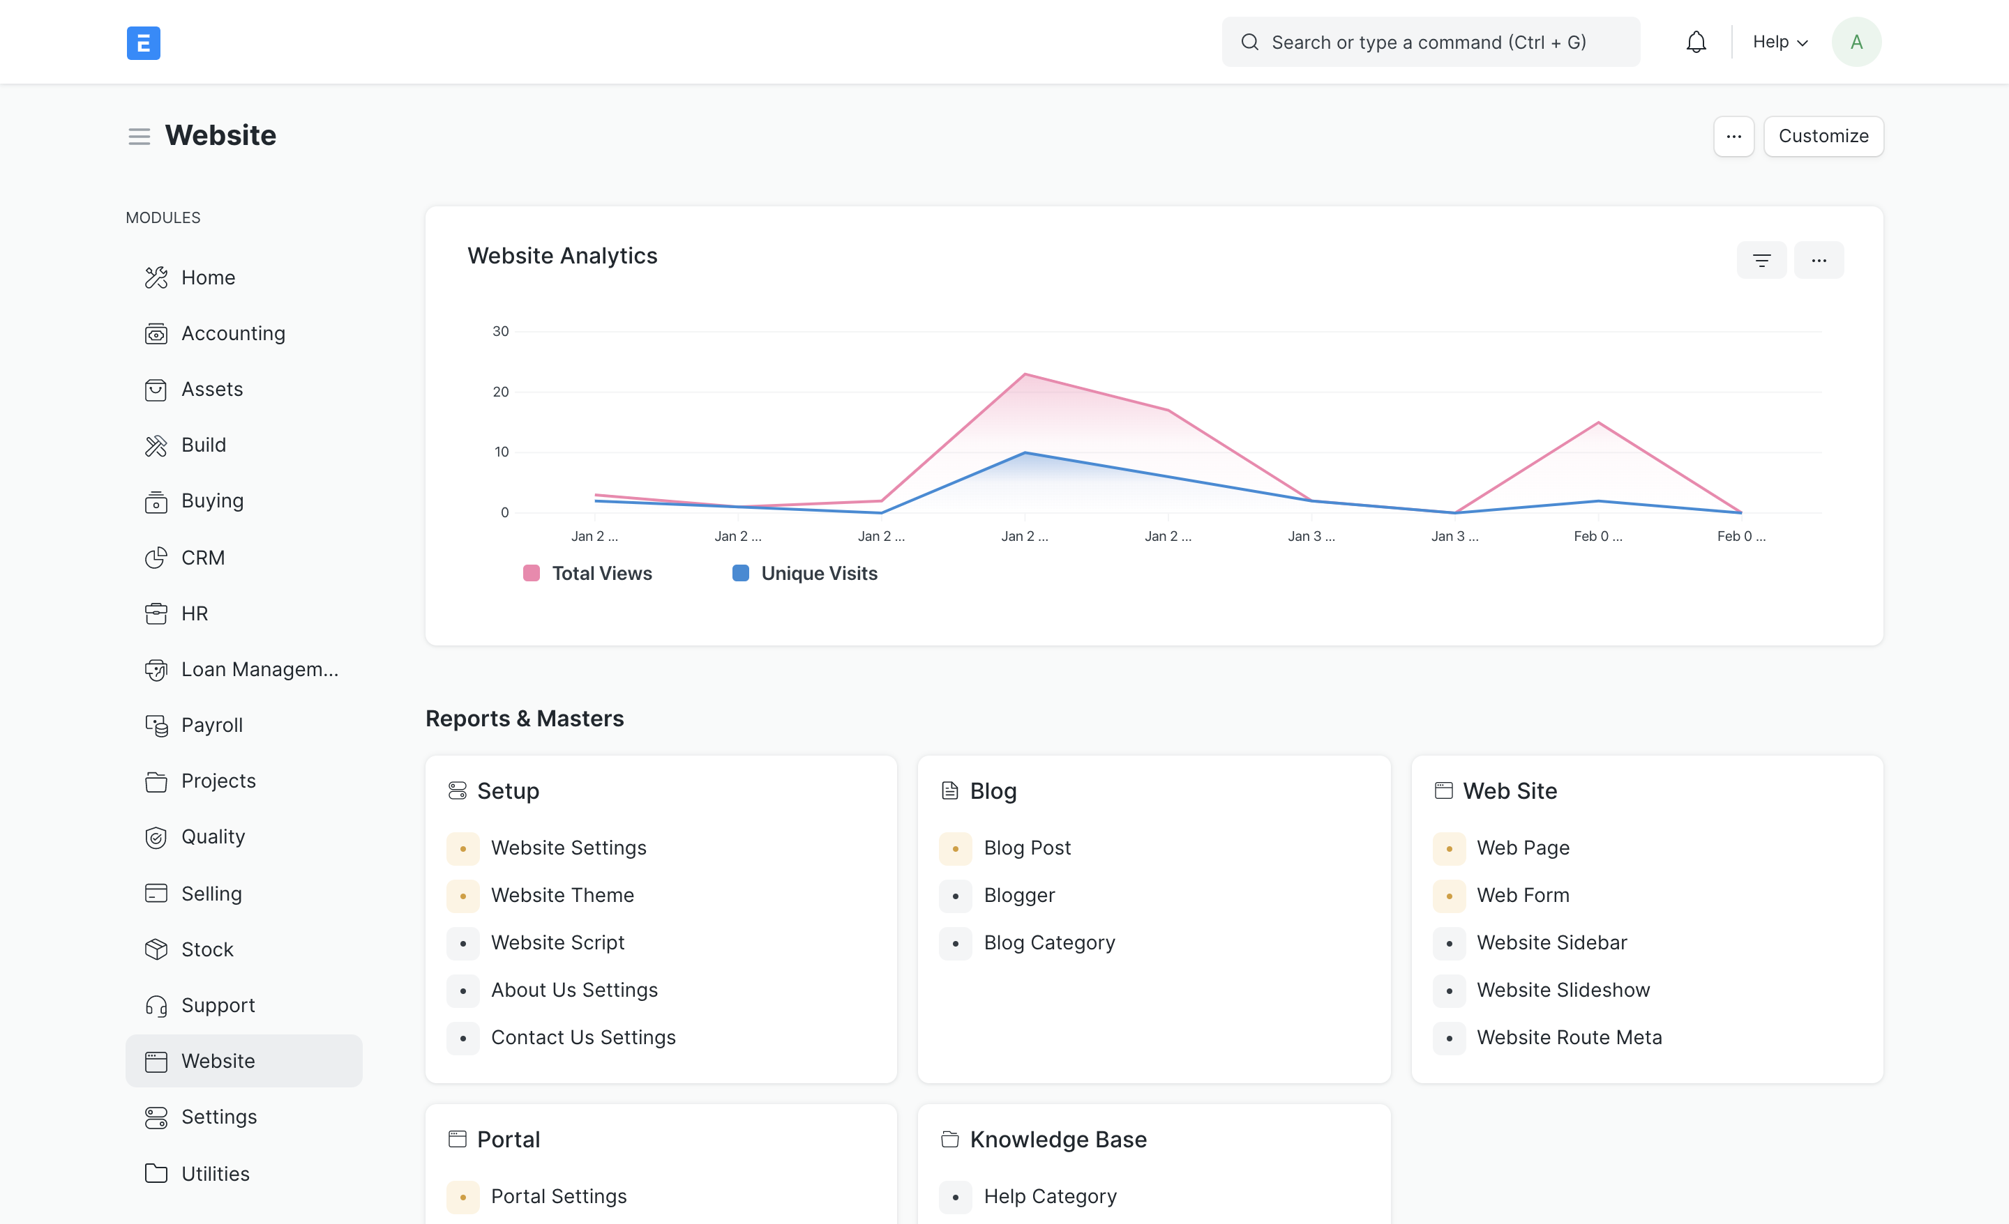
Website

Slide 18
Customization
Report
Custom fields and forms
Print formats
Scripts
Email alerts
Workflows
API integration
Apps / Plugins

Slide 19
Elania Resources Services
Implementation
Data import
Customization
Custom app development
Installation and setup
Hosting
Third party connectors
API Integration

Slide 20
Elania Resources
Any Question?
Website: https://elaniaresources.com
Telegram: https://t.me/elaniaresources
Whatsapp: https://wasap.my/60166323652

